Slide 1
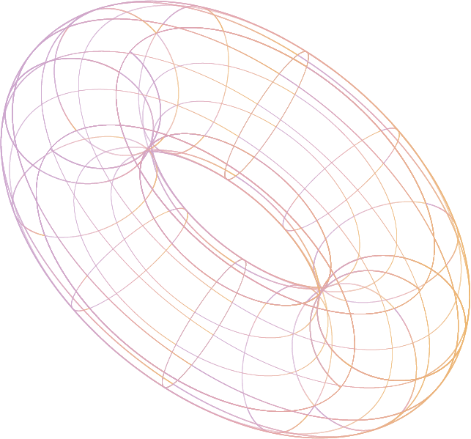

3D Object Generator
articulat3
Development Process, Findings, & Demo
[CSC301 #44] Allen Chen, Sarah Chung, Neeco Fabian, Jasper Mai, Steven Mathew, Max Yang
Notes:
Introducing Articulate, our AI 3D model generator.

Slide 2






The team behind articulat3
Allen Chen
Sarah Chung
Neeco Fabian
Jasper Mai
Steven Mathew
Max Yang
Notes:
he 6 of us have been hard at work bringing this product to life, but first,

Slide 3

Toronto Intelligent Systems Lab
About TISL
About our Partner
Ashkan [PhD in Computer Science]
Algorithms for robot intelligence
Broad applications to intelligent systems
Content creation with 3D objects
Accessibility of 3D assets
Notes:
more on our partner. The Toronto Intelligent Systems lab fosters the next generation of algorithms for robotic intelligence. They work on broad applications related to intelligent systems, and in particular, our point-of-contact Ashkan focuses on 3D objects; content creation with 3D objects and accessibility of 3D assets were the cornerstone of his project vision.

Slide 4
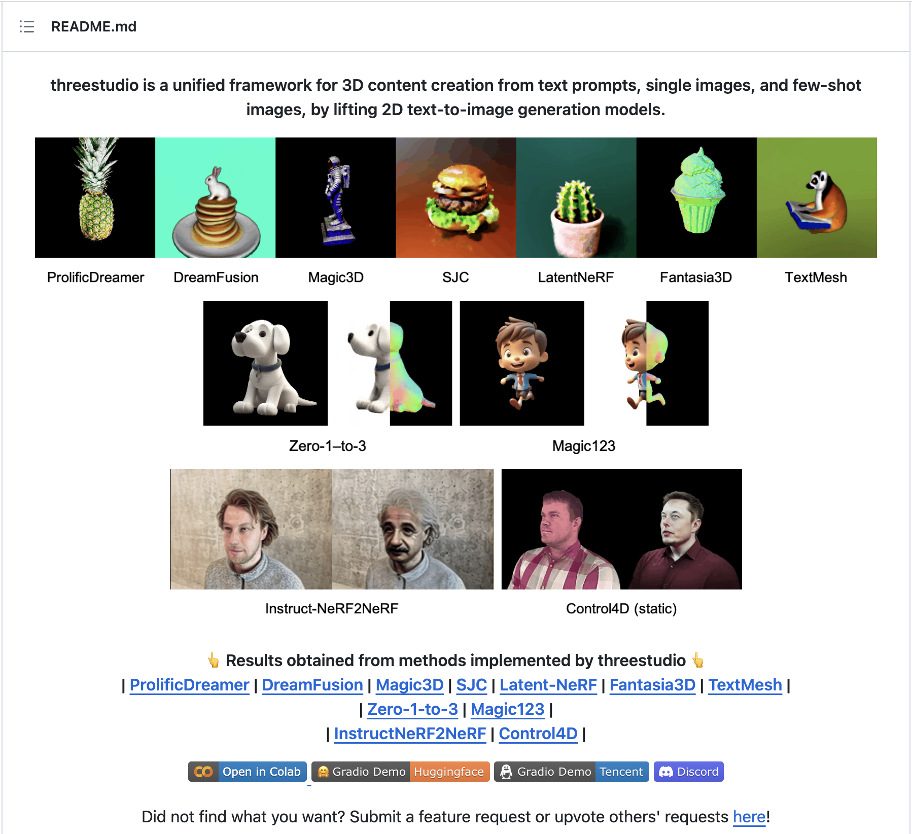

The Problem,
threestudio AI/ML service
User configures settings, desired object
3D object is generated
Main drawbacks
No UI, no data storage, inaccessible
Required extensive knowledge/setup
Notes:
So here was the problem. Our partner had an existing 3D object creation service that leveraged AI and machine learning: the threestudio service. If a user configured a list of settings and specified what object they wanted to generate, like a hamburger, then the 3D hamburger model would appear after a generation period. This was a great product but unfortunately it was very barebones - there was no UI, no database storage, and essentially no way to access the service as the general public. It required an extensive setup to run locally.

Slide 5
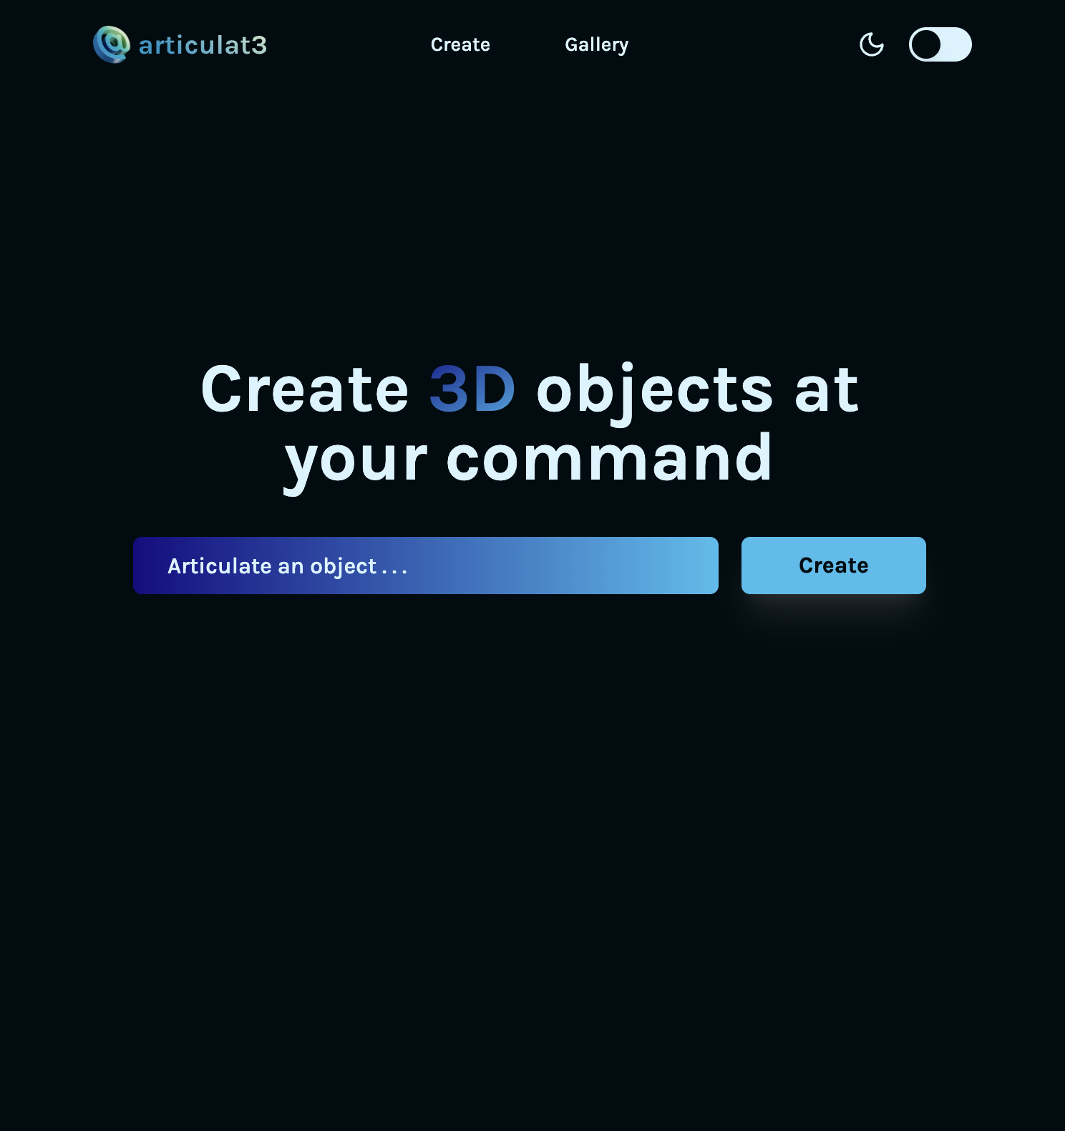
The Solution.
articulat3 web application
Built from scratch
User-friendly interface for the threestudio AI/ML service
Main features
Gallery page for 3D creation inspiration
Create page for 3D object generation
Notes:
That’s where our solution came in. Our group decided to solve Toronto Intelligent Systems from the ground up, creating an easy-to-use web application that leveraged the threestudio service to allow users to generate their own 3D content objects from any user-given text prompt. Our many features will soon be demo-ed and include a gallery of existing 3D creations that anyone can access for inspiration, as well as the main create page that has an intuitive 3D graphic generating process.

Slide 6





User Stories
“Our users are looking to…”
create 3D assets quickly
avoid learning 3D design
use a simple UI
prototype various designs for content
acquire free products
Notes:
Our product is a great, open-sourced solution for content creators, video game developers, and designers. In particular, we’ve identified that our prospective users are looking to:
Create 3D video game assets quickly and brainstorm ideas quickly
Prototype 3D designs to use in their content, without having to learn 3D design from scratch
Acquire free products and produce assets in various styles
Generate assets easily using a simple user interface

Slide 7
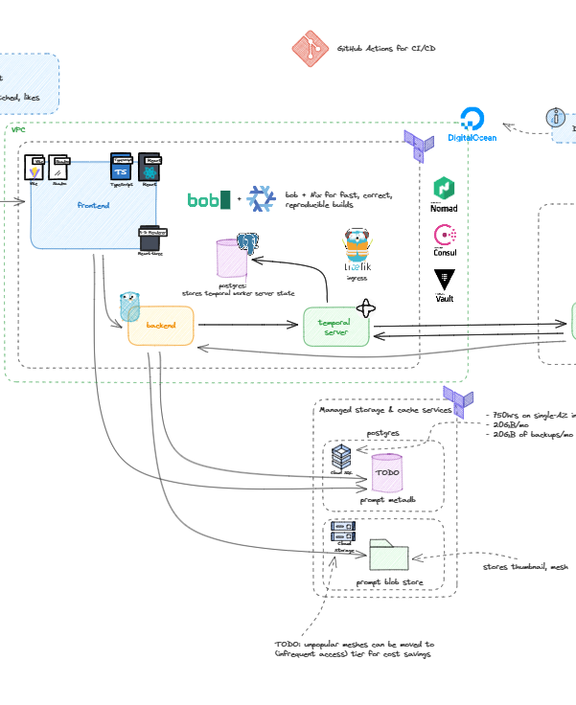
Architecture
https://excalidraw.com/#room=1ba4daa6366aeaa22ab3,lmbCVHcNI8qqEOEJDDmz8g
“Clean architecture” (model, transformer, manager, controller) approach to our overall backend design
Easily extendable. Handlers can be extended and have to implement the openapi definition methods so the handlers struct methods are subset of the interface methods defined by our openapi definition allowing for extension

Slide 8
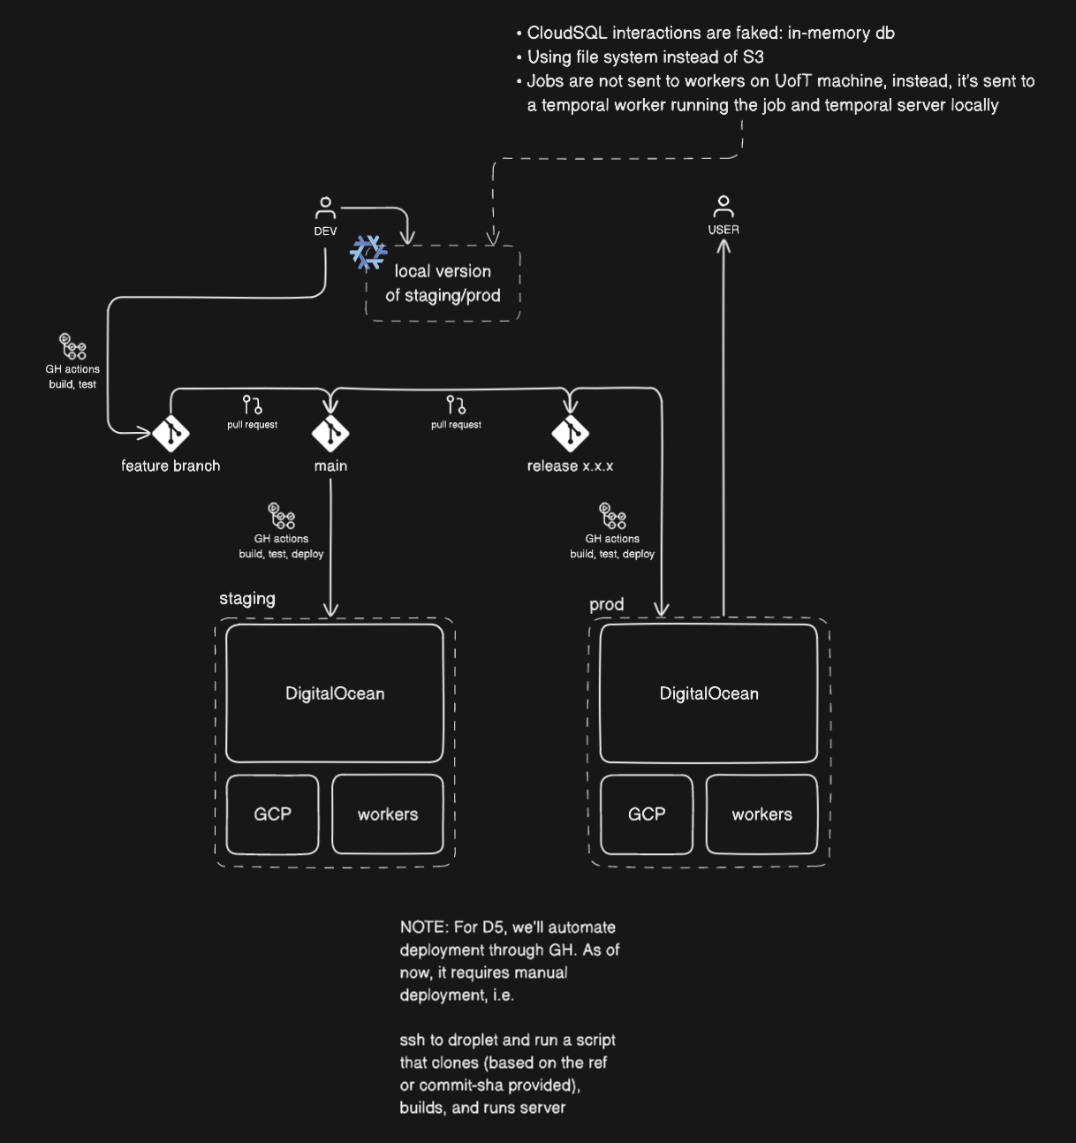
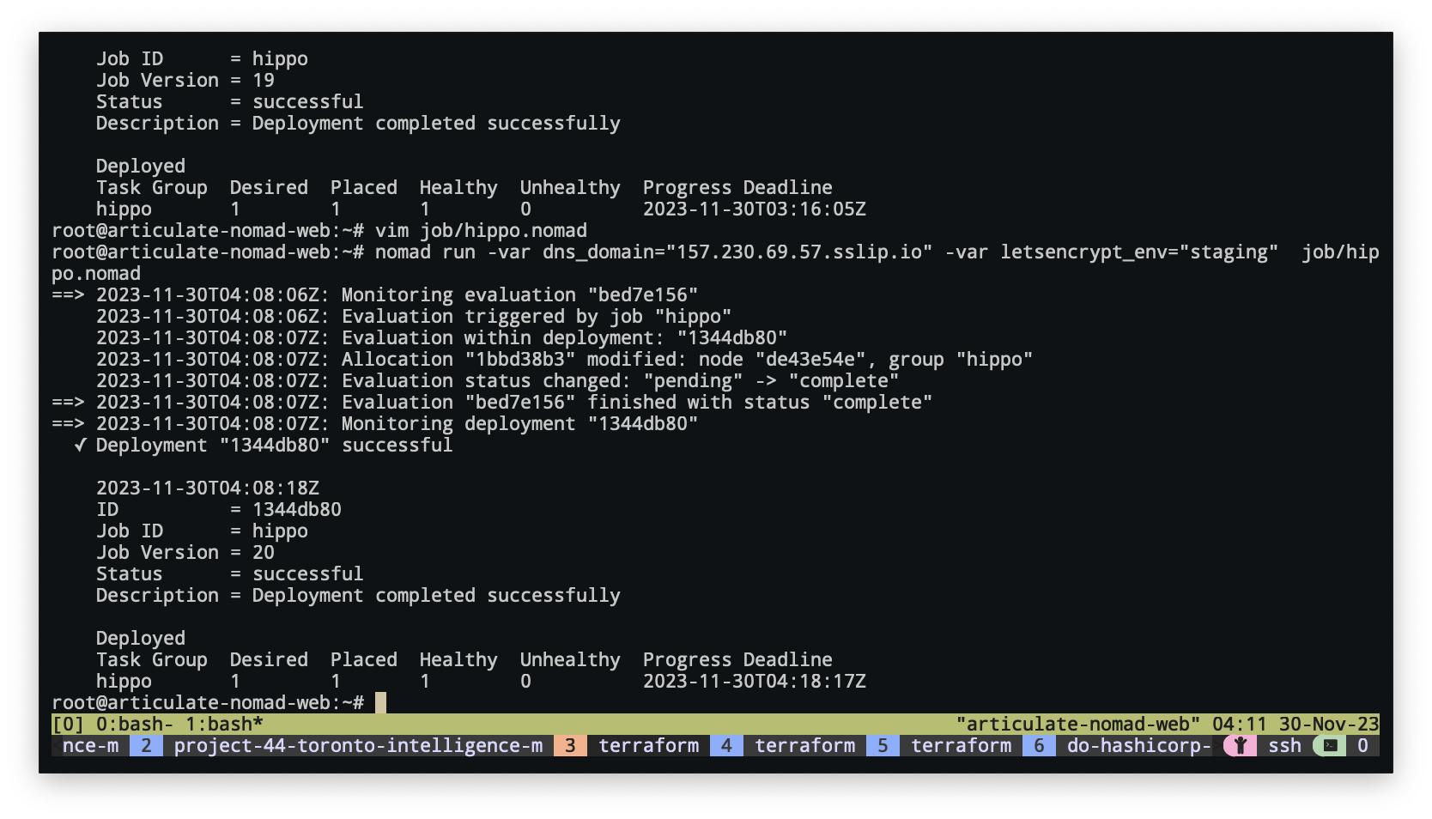
Git flow
https://app.eraser.io/workspace/gAxEJP3exhsJHPLLJNRa?origin=share

Slide 9
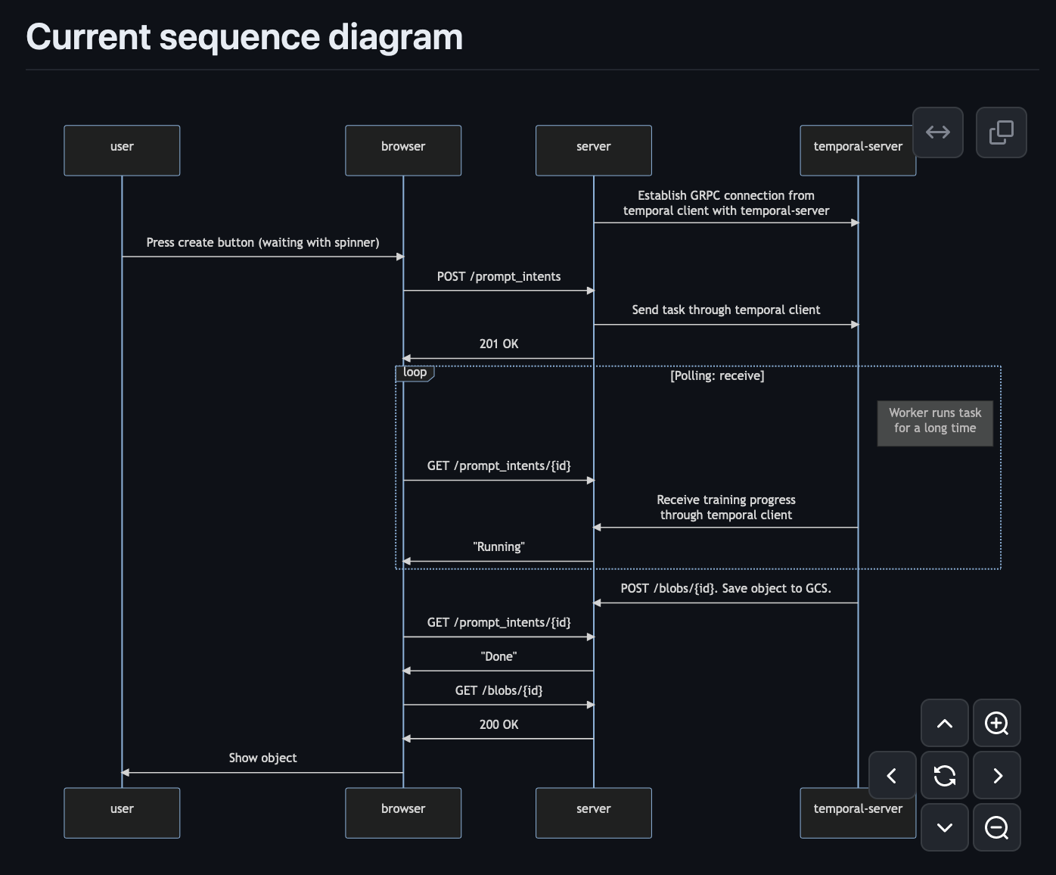
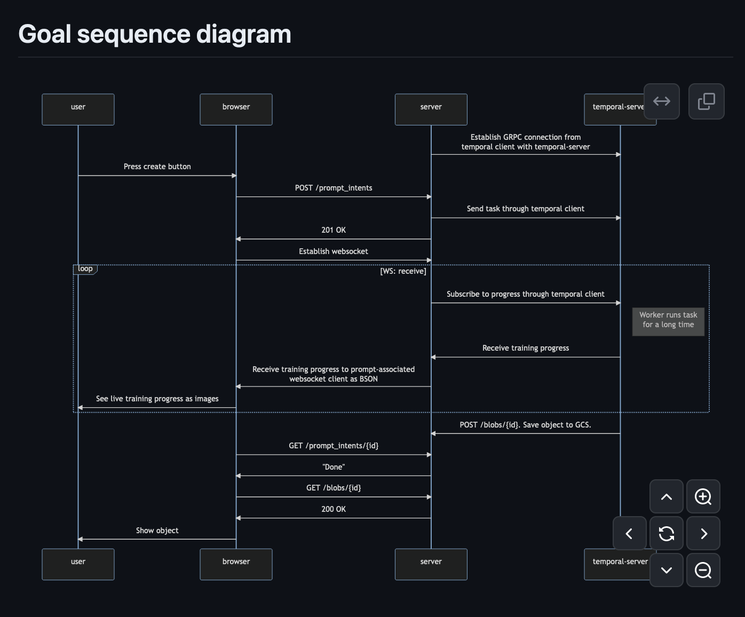
Sequence diagram
https://github.com/csc301-2023-fall/project-44-toronto-intelligence-m/blob/main/doc/sequence.md

Slide 10
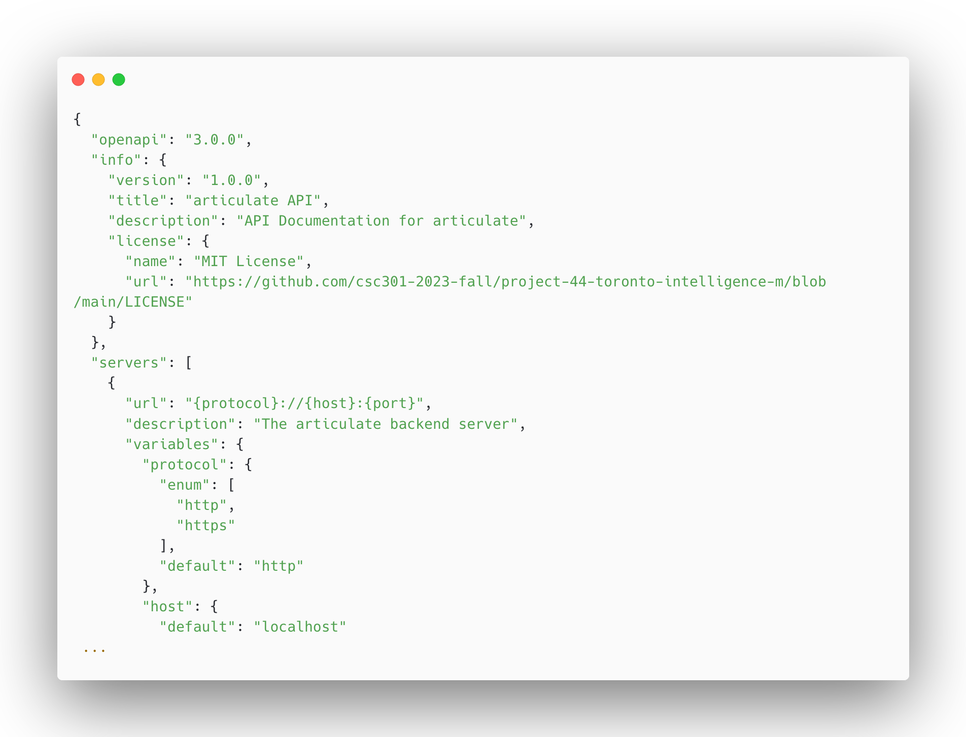
OpenAPI 3.0

Slide 11
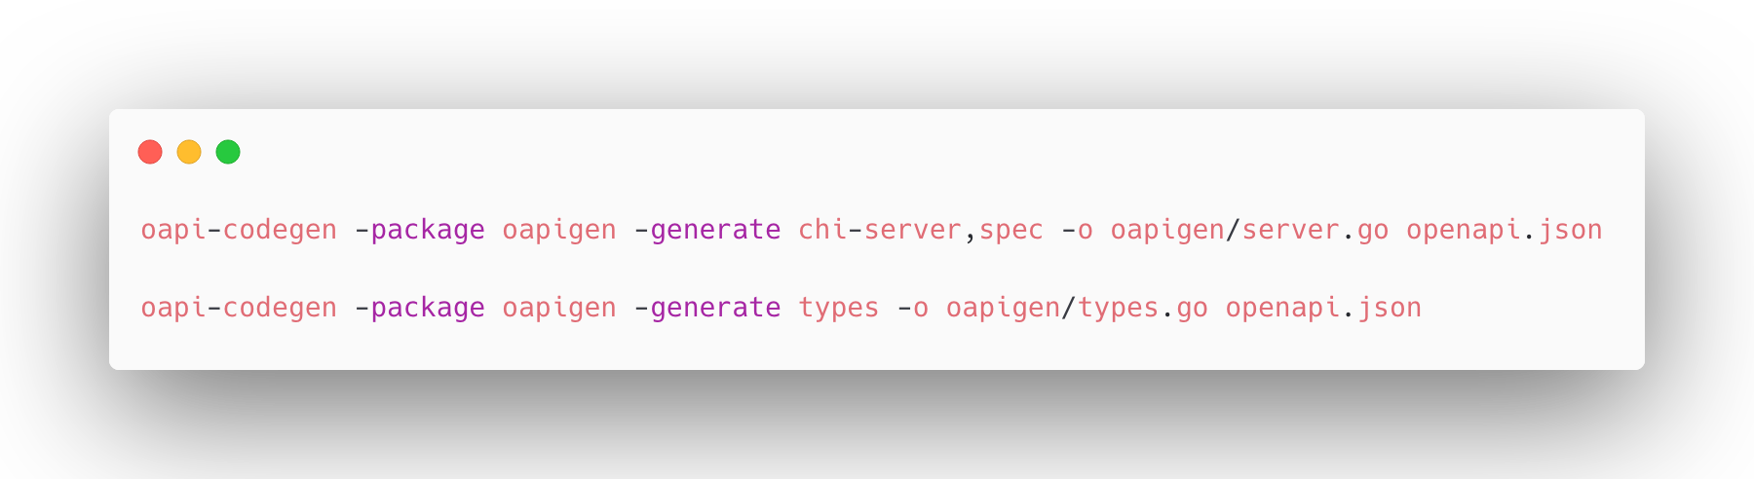
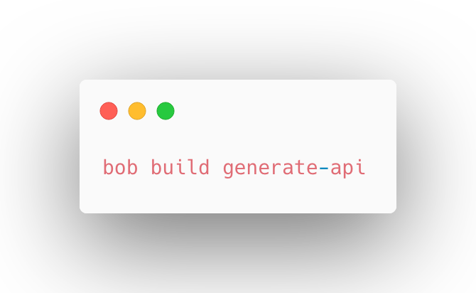
Code generation
=

Slide 12
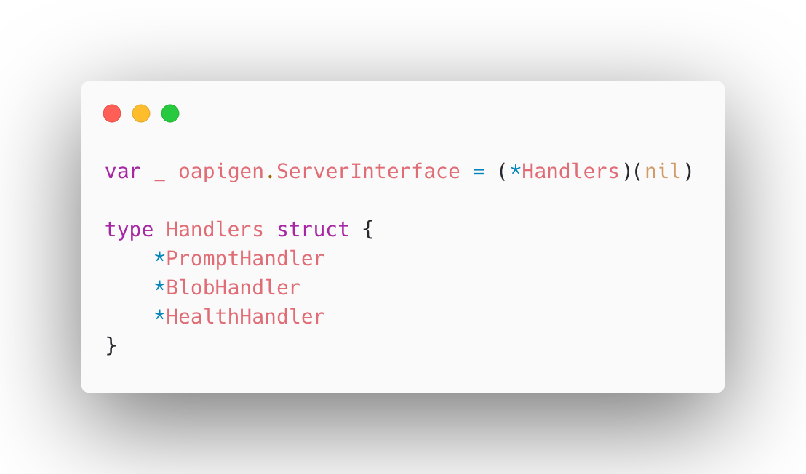
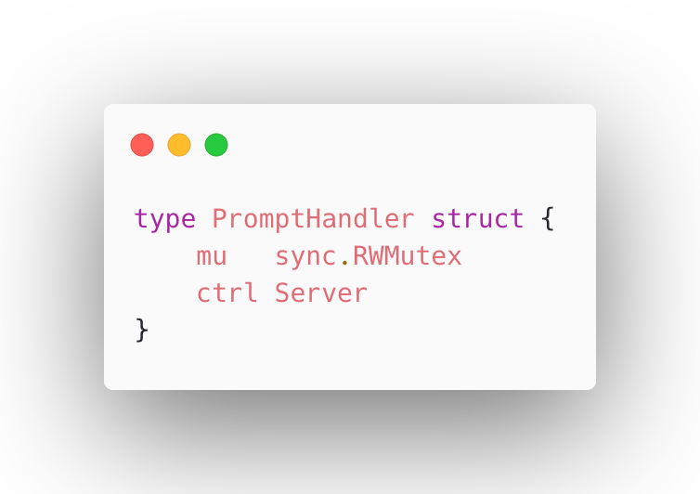
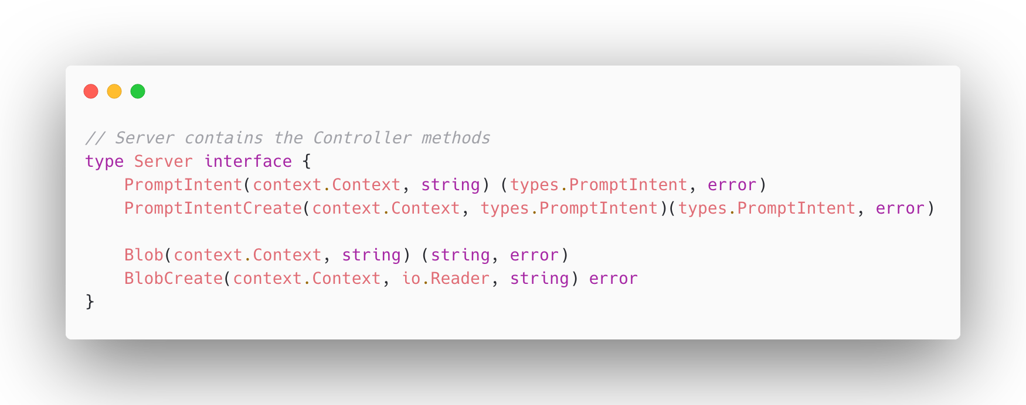

Slide 13
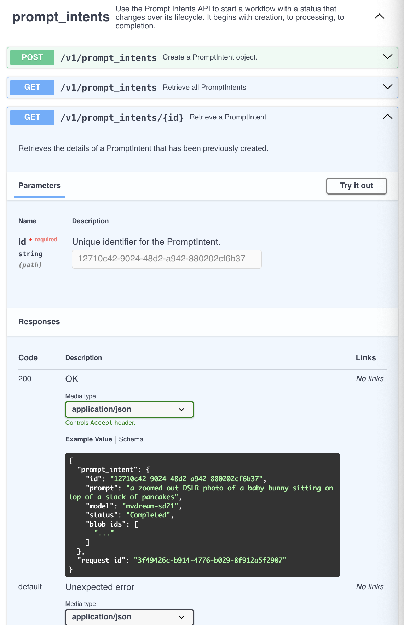
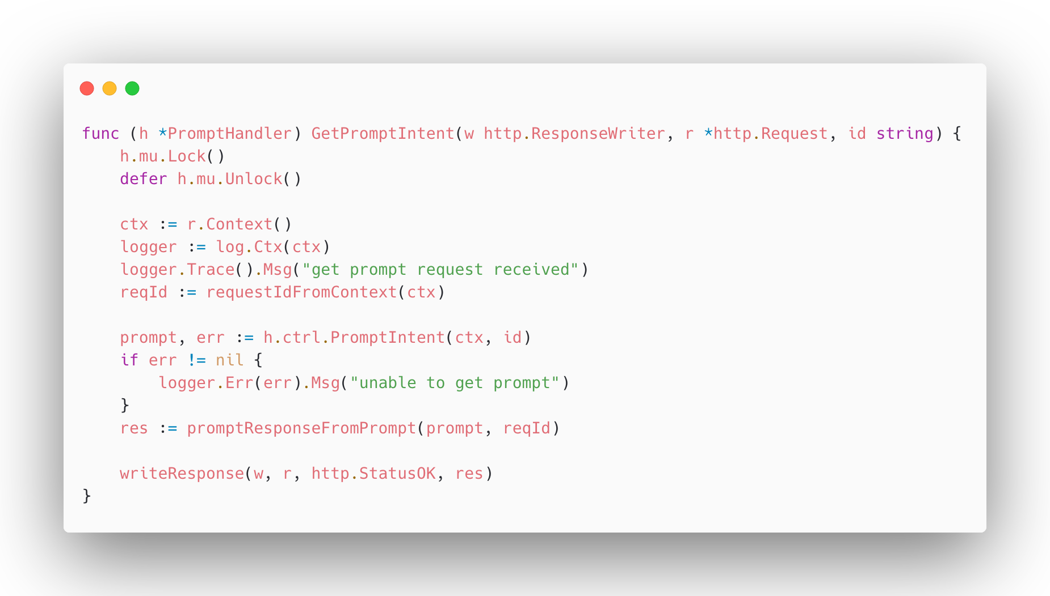

Slide 14
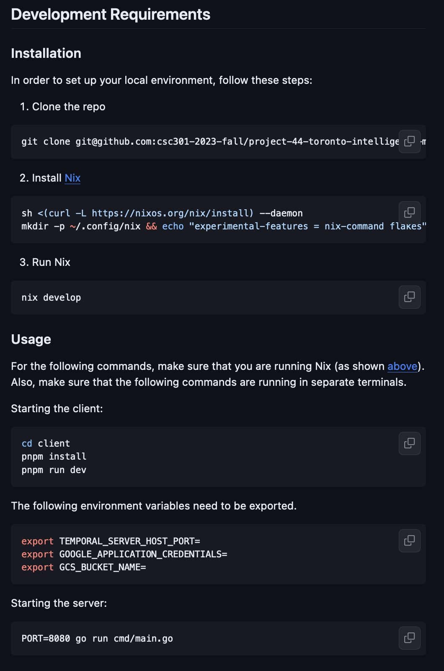
Documentation
Documented each variable that is needed for deployment and will document the necessary secrets to get everything running
Added brief READMEs to subdirectories of the project to explain its purpose and context
Our API is also documented in the spec and the generated static types (in both the frontend and backend) receive the same documentation

Slide 15

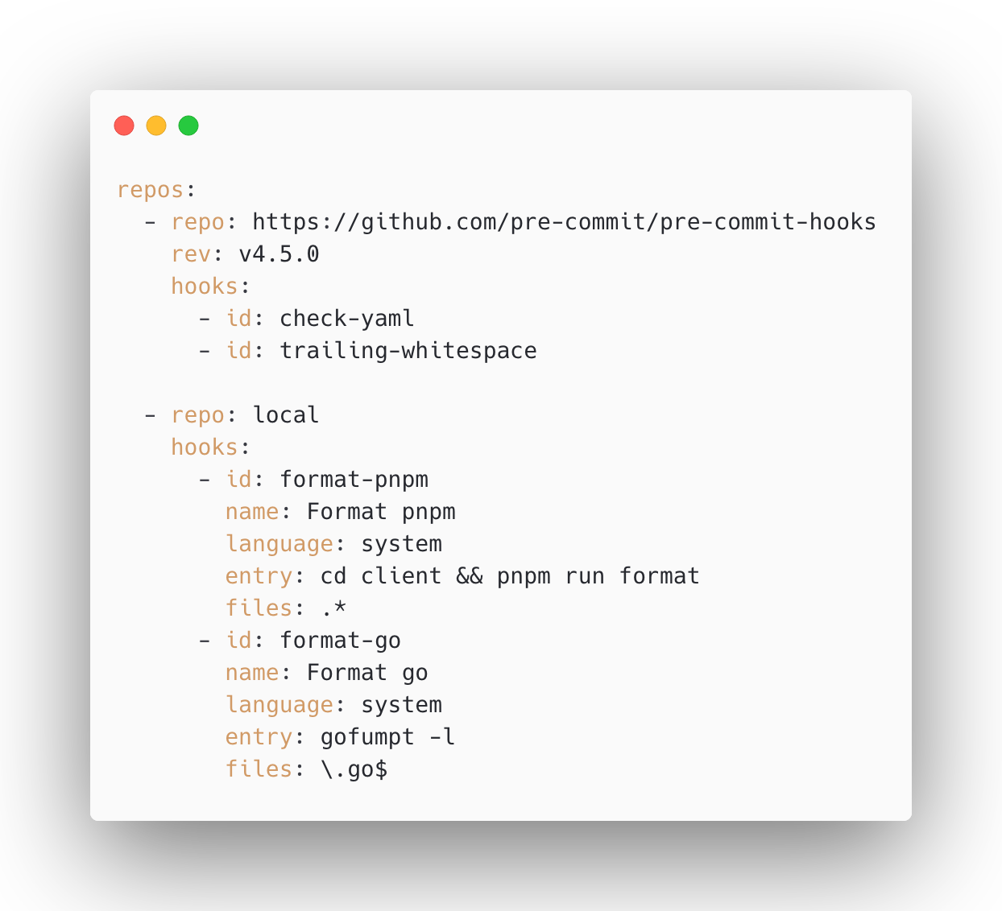



Coding Styles and Practices
Typescript: ESLint and Prettier rules similar to those of Shopify’s
Go: following the standards from Mattermost and Hashicorp as shown.
A pre-commit hook will lint and format all parts of the project. We are also using CI to build and test
Openapi is used for our API which provides openapi (or swagger) documentation
Monorepo, where pnpm and go dependencies are at the top level. Our build system supports incremental builds that are fast, correct, hermetic, and reproducible

Slide 16
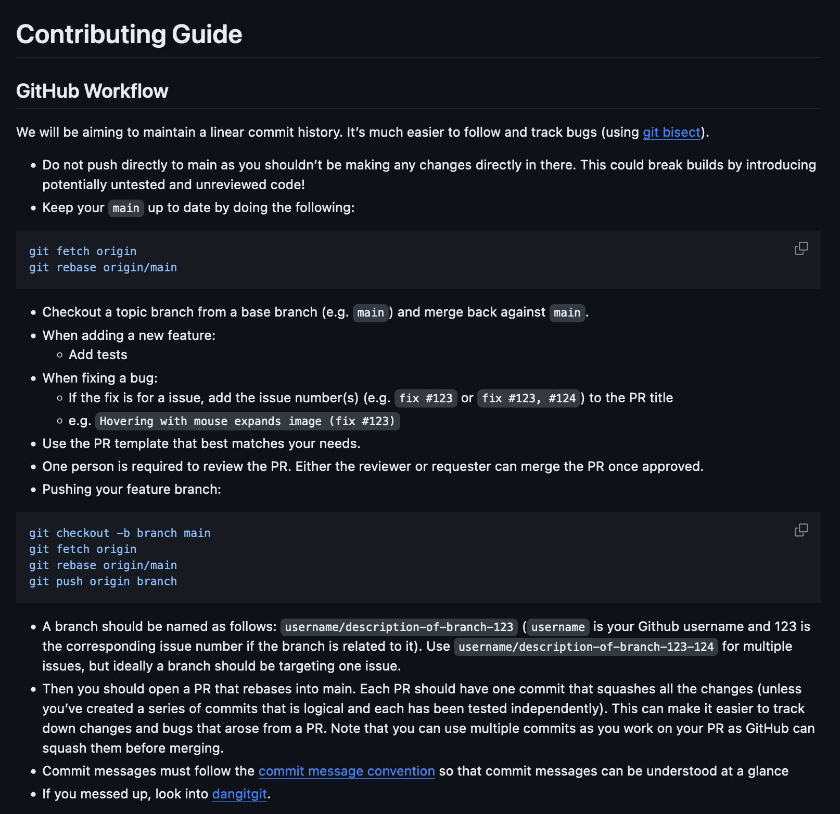

Slide 17

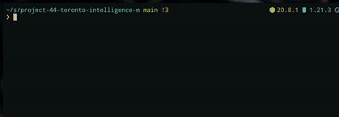
Coding Styles and Practices
Nix for our developer, command-line dependencies and bob for our application and necessary system dependencies allows every developer’s environment to be consistent with staging and production
Nix enables a new developer to get started immediately with every necessary dependency
Allows executing the same build pipeline on localhost and CI, in a deterministic manner

Slide 18
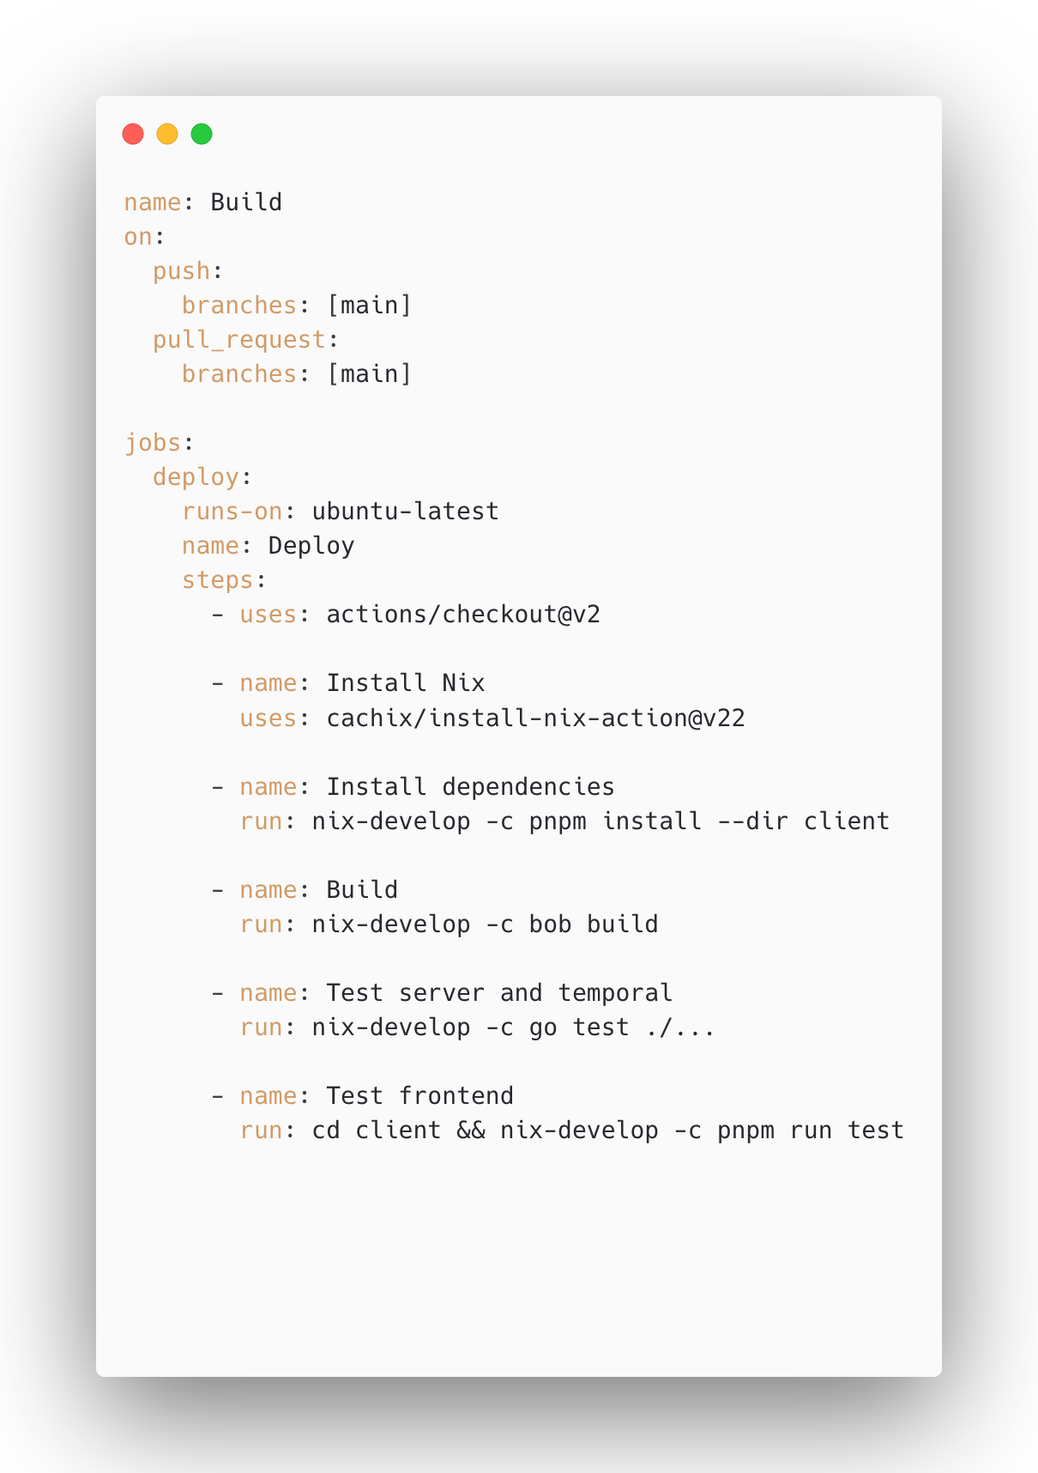
Process & Deployment
Currently: GitHub Actions for CI. Goal is one click deployments with workflow dispatches for our frontend, backend, and temporal workers.
DigitalOcean droplet and GCP resources provisioned with Terraform.
The frontend and backend are deployed to DigitalOcean and orchestrated with Hashicorp Nomad.
Everything is automated through plenty of build scripts
Nix allows staging and prod to be as close as possible.

Slide 19
Process & Deployment: Demo

Slide 20
Deployment & Accessing the App
Next Steps
Handoff
Finishing the Gallery page
Cloud SQL implementation
Store secrets in Hashicorp Vault
Websocket progress
One click deployment
For partner: buy a domain!
Github repo clone/fork + transfership of automatic deployment workflows
DigitalOcean (create PA token) + Vault token
The vault token can be used to unseal the vault and our partner will see all the secrets stored inside
Documentation
Because deployment instructions are changing, we want to hand this off to our partner when it is finalized

Slide 21


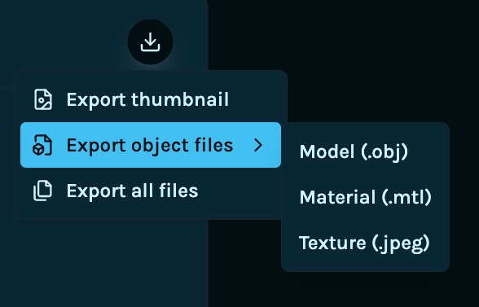


Reflection & Key Learnings
Technical
Frontend
Backend
Incorporated shadcn/ui library base components for composite components.
Contributed to articulat3’s visual consistency and original design language.
Leveraged oapi-codegen and openapi-typescript for Go and Typescript code (respectively) using our OpenAPI JSON.
Led to statically typed methods and objects for the articulat3 API.

Slide 22

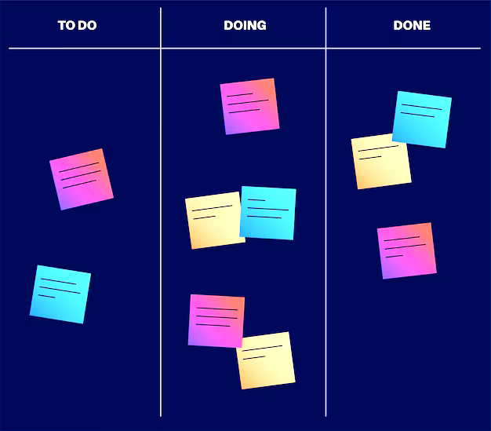
Reflection & Key Learnings
Team Processes
Pair-Programming
During Model Deployment
Useful for establishing standards at the start of D2 and D3.
• frontend shadcn/ui setup
• backend systems setup
Eventually slowed down productivity. Should shorten pair-programming phases.
Unforeseen delays, required rescheduling.
Frequent sync-ups and Kanban workflow kept us informed and productive.
With automated processes, dependency installation is reproducible and hand-off is clear.

Slide 23
Individual Contributions
Allen
Deployed to UofT cluster, resolving Nvidia Cuda incompatibilities using Singularity
Assisted in Temporal implementation
Added in-memory database
Worked on API transformers that convert oapigen to internal types
Sarah
Design all website prototypes on Figma
Develop and style various components within the frontend
Integrate API calls within the Create page
Set up light/dark mode for web app
Ensure responsiveness in the web app
Neeco
Unit test infrastructure setup, implementation
Base components setup
Toast alert notification
Data persistence across pages
Design enhancements for Create page, 3D object viewer
Jasper
Implement interactive 3D object model viewer
Base components setup
Set up main hooks for connecting Create page functionalities (ie. text prompt, button submit)
Design Gallery page enhancements (ie. Search Bar functionalities)
Steven
Deployed to UofT cluster, resolving Nvidia…
Temporal activities implementation
Provisioned Hashi cluster and DO deployments (WIP: Git flow, CD, vault secrets)
Build system for hermeticity + parity (bob + Nix)
Wrote hooks for frontend to query backend API, providing generated static API types
Overall architecture + technology decisions
Max
Temporal activities implementation
Deployed to UofT cluster, resolving Nvidia Cuda incompatibilities using Singularity
Added CI build workflow
Created blobstore GCS Client

